Slide 1
Best-first Search
Idea: select the path whose end is closest to a goal according to the heuristic function.
Best-first search selects a path on the frontier with minimal h-value.
It treats the frontier as a priority queue ordered by h.

Slide 2
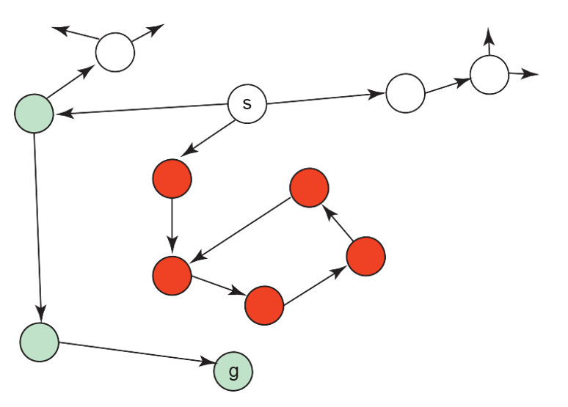
Illustrative Graph - Best-First Search

Slide 3
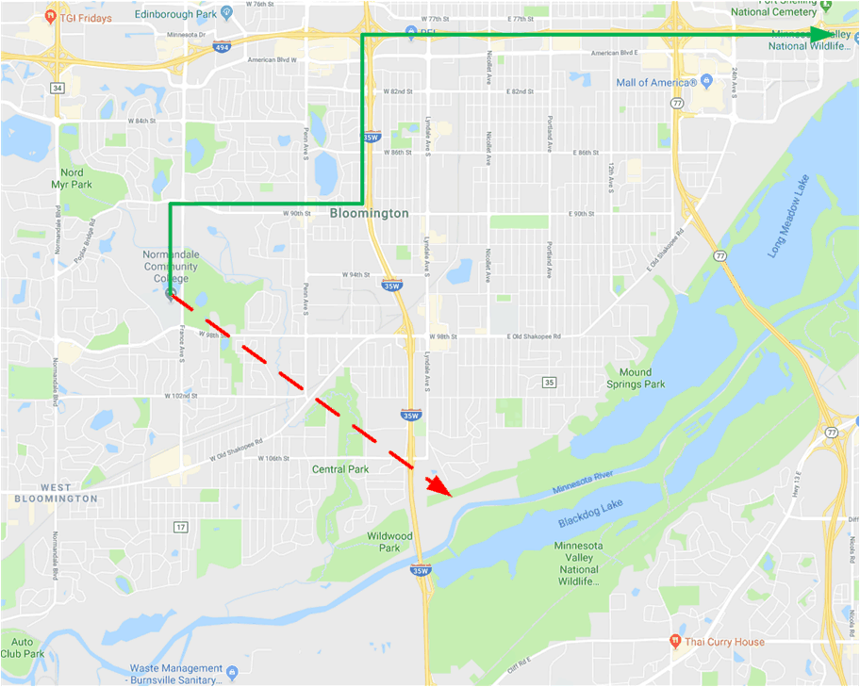
Illustrative Graph 2 - Best-First Search
If I wanted to minimize distance to Chicago, best-first-search would always move southwest…bad idea!

Slide 4
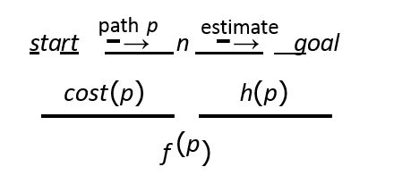
A* Search
A* search uses both path cost and heuristic values
cost(p) is the cost of path p.
h(p) estimates the cost from the end of p to a goal.
Let f(p) = cost(p) + h(p)
f(p) estimates the total path cost of going from a start node to a goal via p.

Slide 5
A* Search Algorithm
A* is a mix of lowest-cost-first and best-first search.
It treats the frontier as a priority queue ordered by f(p).
It always selects the node on the frontier with the lowest estimated distance from the start to a goal node constrained to go via that node.

Slide 6
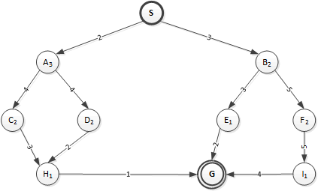
Worked A* Search Example
Number in a node is the h(p) cost from that node to node G.
Breaking ties alphabetically
node | Priority Queue After Expanding Node (only 1st pos fixed)
 | n | f | via | n | f | via | n | f | via | n | f | via
S | A | 5 | S | B | 5 | S
A | B | 5 | S | C | 8 | SA | D | 8 | SA
B | E | 7 | SB | C | 8 | SA | D | 8 | SA | F | 10 | SB
E | G | 8 | SBE | C | 8 | SA | D | 8 | SA | F | 10 | SB
G

Slide 7
Complexity of A* Search
Does A* search guarantee to find the shortest path or the path with the fewest arcs?
What happens on infinite graphs or on graphs with cycles if there is a solution?

Slide 8
Admissibility of A*
If there is a solution, A* always finds an optimal solution – the first path to a goal selected – if
The branching factor is finite
Arc costs are bounded above zero
There is some c > 0 such that all of the arc costs are greater than c
h(n) is nonnegative and an underestimate of the cost of the shortest path from n to a goal node.

Slide 9
Why is A* Admissible?
If a path p to a goal is selected from a frontier, can there be a shorter path to a goal?
Suppose path p’ is on the frontier. Because p was chosen before p’, and h(p) = 0:

Slide 10
Why is A* Admissible?
If a path p to a goal is selected from a frontier, can there be a shorter path to a goal?
Suppose path p’ is on the frontier. Because p was chosen before p’, and h(p) = 0:
cost(p) ≤ cost(p’) + h(p’)

Slide 11
Why is A* Admissible?
If a path p to a goal is selected from a frontier, can there be a shorter path to a goal?
Suppose path p’ is on the frontier. Because p was chosen before p’, and h(p) = 0:
cost(p) ≤ cost(p’) + h(p’)
Because h is an underestimate:
cost(p’) + h(p’) ≤ cost(p’’), for any path p’’ to a goal that extends p’.
So cost(p) ≤ cost(p’’) for any other path p’’ to a goal.

Slide 12
Why is A* Admissible?
A* can always find a solution if there is one:
The frontier always contains the initial part of a path to a goal, before that goal is selected.
A* halts, as the costs of the paths on the frontier keeps increasing, and will eventually exceed any finite number.

Slide 13
How Do Good Heuristics Help?
Suppose c is the cost of an optimal solution. What happens to a path p where
cost(p) + h(p) < c
cost(p) + h(p) = c
cost(p) + h(p) > c
How can a better heuristic function help?

Slide 14
Multiple-Path Pruning and Optimal Solutions
Problem: What if a subsequent path to goal n is shorter than the first path to n?
Remove all paths from the frontier that use the longer path, and change the initial segment of the paths on the frontier to use the shorter path.
Ensure this doesn’t happen. Make sure that the shortest path to a node is found first.
This can be done with monotone restriction.

Slide 15
Monotone Restriction
A nonnegative heuristic function h(n) on node n satisfies monotone restriction if, for any edge <n,n’>:
h(n) ≤ cost(n,n’) + h(n’)
If the heuristic function satisfies the monotone restriction for all pairs of nodes, it is a consistent heuristic.
Note in this case |h(n)-h(n’)| ≤ cost(n,n’).
In this case, A* search will not only find the shortest path to the goal node first, but the first path it finds to any other node is also the shortest path to that node.

Slide 16
Monotone Restriction
Heuristic function h satisfies the monotone restriction if
|h(m) – h(n)| ≤ cost(m,n) for every arc (m,n)
If h satisfies the monotone restriction, A* with multiple path pruning always finds the shortest path to a goal.
This is a strengthening of the admissibility criterion.

Slide 17
Bounded Depth-First Searches
There are a couple of modifications to DFS that are popular:
Iterative deepening
Depth-first Branch-and-bound

Slide 18
Bounded DFS
A bounded depth-first search takes a bound (cost or depth) and does not expand paths that exceed the bound.
Explores part of the search graph
Uses space linear in the depth of the search
How does this relate to other searches?
How can this be extended to be complete?

Slide 19
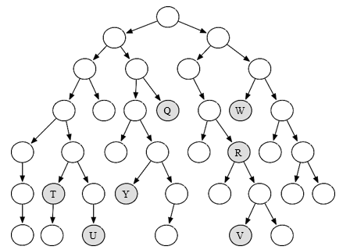
Which shaded goal will bounded DFS find first?
It depends on the original bound.
And on whether we go right or left first.

Slide 20
Iterative Deepening Search
Iterative deepening search:
Start with bound b = 0
Do a bounded depth-first search with bound b
If a solution is found return that solution
Otherwise increment b and repeat

Slide 21
Iterative Deepening Search
Iterative deepening search:
Start with bound b = 0
Do a bounded depth-first search with bound b
If a solution is found return that solution
Otherwise increment b and repeat
This will find the same first solution as what other method?

Slide 22
Iterative Deepening Search
Iterative deepening search:
Start with bound b = 0
Do a bounded depth-first search with bound b
If a solution is found return that solution
Otherwise increment b and repeat
This will find the same first solution as what other method?
How much space is used?
What happens if there is no path to a goal?

Slide 23
Iterative Deepening Search
Iterative deepening search:
Start with bound b = 0
Do a bounded depth-first search with bound b
If a solution is found return that solution
Otherwise increment b and repeat
This will find the same first solution as what other method?
How much space is used?
What happens if there is no path to a goal?
Surely recomputing paths is wasteful!

Slide 24
Iterative Deepening Complexity
Complexity with solution at depth k and branching factor b:
Level | Times node at this level is processed in BFS | Times node at this level is processed in ID-DFS | Number of nodes at this level
1 | 1 | k | b
2 | 1 | k-1 | b²
… | … | … | …
K-1 | 1 | 2 | b^{k-1}
k | 1 | 1 | b^{k}
TOTAL

Slide 25
Iterative Deepening Complexity
Complexity with solution at depth k and branching factor b:
Level | Times node at this level is processed in BFS | Times node at this level is processed in ID-DFS | Number of nodes at this level
1 | 1 | k | b
2 | 1 | k-1 | b²
… | … | … | …
k-1 | 1 | 2 | b^{k-1}
k | 1 | 1 | b^{k}
TOTAL Nr. NODES PROCESSED | ≥ b^{k} | ≤ (b/b-1)² b^{k}

Slide 26
Depth-first Branch and Bound
Combines DFS with heuristic information.
Finds optimal solution.
Most useful when there are multiple solutions, and we want an optimal one.
Uses the space of DFS.

Slide 27
Depth-first Branch and Bound
Suppose we want to find a single optimal solution.
Suppose bound is the cost of the lowest-cost path found to a goal so far.
What if the search encounters a path p such that
cost(p) + h(p) ≥ bound?

Slide 28
Depth-first Branch and Bound
Suppose we want to find a single optimal solution.
Suppose bound is the cost of the lowest-cost path found to a goal so far.
What if the search encounters a path p such that
cost(p) + h(p) ≥ bound?
p can be pruned
What can we do if a non-pruned path to a goal is found?

Slide 29
Depth-first Branch and Bound
Suppose we want to find a single optimal solution.
Suppose bound is the cost of the lowest-cost path found to a goal so far.
What if the search encounters a path p such that
cost(p) + h(p) ≥ bound?
p can be pruned
What can we do if a non-pruned path to a goal is found?
Bound can be set to the cost of p, and p can be remembered as the best solution so far.
Why should this use a depth-first search?

Slide 30
Depth-first Branch and Bound
Suppose we want to find a single optimal solution.
Suppose bound is the cost of the lowest-cost path found to a goal so far.
What if the search encounters a path p such that
cost(p) + h(p) ≥ bound?
p can be pruned
What can we do if a non-pruned path to a goal is found?
Bound can be set to the cost of p, and p can be remembered as the best solution so far.
Why should this use a depth-first search?
Uses linear space
What can be guaranteed when the search completes?
It has found an optimal solution.
How should the bound be initialized?

Slide 31
Depth-first Branch and Bound: Initializing Bound
The bound can be initialized to ∞
The bound can be set to an estimate of the optimal path cost. After depth-first search terminates either:

Slide 32
Depth-first Branch and Bound: Initializing Bound
The bound can be initialized to ∞
Or the bound can be set to an estimate of the optimal path cost. After depth-first search terminates either:
A solution was found
No solution was found, and no path was pruned
No solution was found, and a path was pruned

Slide 33
How will the best solution evolve?
Assume you search left to right and start with bound = ∞

Slide 34
Direction of Search
The definition of searching is symmetric: find path from start nodes to goal nodes or from goal nodes to start nodes.
Forward branching factor: number of arcs out of a node.
Backward branching factor: number of arcs into a node.
Search complexity is b^{n}. Should use forward search if forward branching factor is less than backward branching factor, and vice versa.
Note: When graph is dynamically constructed, the backwards graph may not be available.

Slide 35
Bidirectional Search
Idea: search backward from the goal and forward from the start simultaneously.
This wins as 2b^{k/2} << b^{k}. This can result in an exponential saving in time and space.
The main problem is making sure the frontiers meet.
This is often used with one breadth-first method that builds a set of locations that can lead to the goal. In the other direction, another method can be used to find a path to these interesting locations.

Slide 36
Island-Driven Search
Idea: find a set of islands between s and g.
S → i₁ → i₂ → … → i_{m-1} → g
There are m smaller problems rather than 1 big problem.
This can win as mb^{k/m} << b^{k}.
The problem is to identify the islands that the path must pass through. It is difficult to guarantee optimality.
The subproblems can be solved using islands → hierarchy of abstractions.

Slide 37
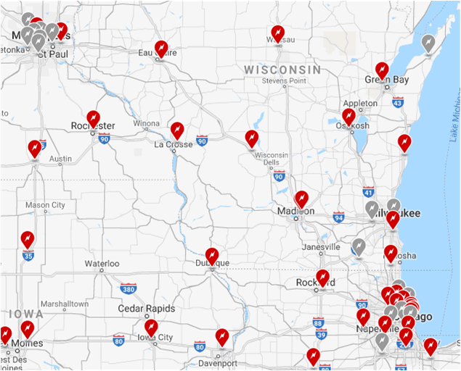
Driving a Tesla from here to Chicago
You don’t have the range to make it in one charge, but you do have the range to make it in two charges.
The islands are the location of Tesla superchargers.

Slide 38
Dynamic Programming
Idea: for statically stored graphs, build a table of dist(n) the actual distance of the shortest path from node n to a goal. This can be build backwards from the goal:
This can be used locally to determine what to do. There are two main problems:
It requires enough space to store the graph.
The dist function needs to be recomputed for each goal.
We will talk about Dynamic Programming a lot in future weeks.

